Slide 1

Information Technology Project Management
Software Project Planning
http://www.stellman-greene.com

Slide 2
Who needs software?
Most software is built in organizations for people with specific needs.
  A stakeholder is a anyone who has an interest (or stake) in the software being completed
  A user is someone who will need to use the software to perform tasks.
  Sometimes stakeholders will be users; but often the stakeholder will not use the software.
    For example, a senior manager (like a CEO or CTO in a company) will usually have a stake in the software that is built (since it affects the bottom line), even if she won’t ever use it.
http://www.stellman-greene.com

Slide 3
Who builds software?
Software is typically built by a team of software engineers, which includes:
  Business analysts or requirements analysts who talk to users and stakeholders, plan the behavior of software and write software requirements
  Designers and architects who plan the technical solution
  Programmers who write the code
  Testers who verify that the software meets its requirements and behaves as expected
http://www.stellman-greene.com

Slide 4
Project Management
The project manager plans and guides the software project
  The project manager is responsible for identifying the users and stakeholders and determining their needs
  The project manager coordinates the team, ensuring that each task has an appropriate software engineer assigned and that each engineer has sufficient knowledge to perform it
  To do this well, the project manager must be familiar with every aspect of software engineering
http://www.stellman-greene.com

Slide 5
Identifying Needs
The project manager drives the scope of the project.
  The project manager should identify and talk to the main stakeholder
  The effective way to show stakeholders that their needs are understood and that those specific needs will be addressed is with a vision and scope document
http://www.stellman-greene.com

Slide 6
Vision and Scope Document
A typical vision and scope document follows an outline like this one:
    Problem Statement
      Project background
      Stakeholders
      Users
      Risks
      Assumptions
    Vision of the Solution
      Vision statement
      List of features
      Scope of phased release (optional)
      Features that will not be developed
http://www.stellman-greene.com

Slide 7
Project Plan
The project plan defines the work that will be done on the project and who will do it. It consists of:
  A statement of work (SOW) that describes all work products that will be produced and a list of people who will perform that work
  A resource list that contains a list of all resources that will be needed for the product and their availability
  A work breakdown structure and a set of estimates
  A project schedule
  A risk plan that identifies any risks that might be encountered and indicates how those risks would be handled should they occur
http://www.stellman-greene.com

Slide 8
Statement of Work
The statement of work (SOW) is a detailed description of all of the work products which will be created over the course of the project. It includes:
  A list of features that will be developed
  A description of each intermediate deliverable or work product that will be built.
  The estimated effort involved for each work product to be delivered
http://www.stellman-greene.com

Slide 9
Resource List
The project plan should contain a list of all resources that will be used on the project.
  A resource is a person, hardware, room or anything else that is necessary for the project but limited in its availability
  The resource list should give each resource a name, a brief one-line description, and list the availability and cost (if applicable) of the resource
http://www.stellman-greene.com

Slide 10
Estimates and Project Schedule
The project plan should also include estimates and a project schedule:
  A work breakdown structure (WBS) is defined. This is a list of tasks which, if performed, will generate all of the work products needed to build the software.
  An estimate of the effort required for each task in the WBS is generated.
  A project schedule is created by assigning resources and determining the calendar time required for each task.
Estimates and project schedules will be discussed in detail in later slides.
http://www.stellman-greene.com

Slide 11
Risk Plan
A risk plan is a list of all risks that threaten the project, along with a plan to mitigate some or all of those risks.
  The project manager selects team members to participate in a risk planning session:
    The team members brainstorm potential risks
    The probability and impact of each risk is estimated
    A risk plan is constructed
http://www.stellman-greene.com

Slide 12
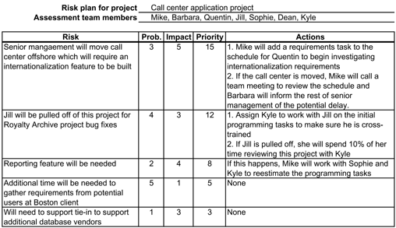
Risk Plan Example
http://www.stellman-greene.com

